Slide 1
Reproducible Statistical Inference
James L Rosenberger
July 10, 2017

Slide 2
Outline
Reproducibility
Design of Experiments Principles
Good statistical Practice
Example of Statistical Practice
Court challenge of accuracy of BAC testing
Use of Inter-laboratory testing to establish accuracy

Slide 3
Reproducibility
Three basic concepts of reproducibility in research
1. Reproducible experiments
2. Reproducible analysis
3. Reproducible inference

Slide 4
Reproducibility
Three basic concepts of reproducibility in research
1. Reproducible experiments
Another lab can repeat your experiment and get similar results
2. Reproducible analysis
Another analyst (or yourself) can reanalyze your data and obtain the identical results
3. Reproducible inference
Another lab can reproduce your experiment and come to similar scientific conclusions

Slide 5
Publication Standards
To accomplish reproducible experiments
Must provide clear a description of how your experiment was done
Requires a detailed protocol
Population sampled
Handling of materials
Measurement of response
Recording of data should be auditable from instrument to raw data file
Avoid Excel which allows changes without documentation

Slide 6
Reproducible Analysis
Create a script of all steps from reading raw data to producing the report
Markdown in Rstudio
Sweave
SASweave
Minitab Journal
JMP script

Slide 7
Policy: NIH plans to enhance reproducibility Francis S. Collins& Lawrence A. Tabak, Nature 505:612-613, (27 January 2014)
… a complex array of other factors seems to have contributed to the lack of reproducibility. Factors include poor training of researchers in experimental design; increased emphasis on making provocative statements rather than presenting technical details; and publications that do not report basic elements of experimental design. Crucial experimental design elements that are all too frequently ignored include blinding, randomization, replication, sample-size calculation and the effect of sex differences.

Slide 8
Design of Experiments
Sources of Error
Basis for Inference
Random Samples
Randomization
Nested sources of variation
Independence of observations
Blindness / Avoidance of Biases
Generalizability

Slide 9
What is the Difference Between Repeatability and Reproducibility?
https://www.labmate-online.com/news/news-and-views/5/breaking-news/what-is-the-difference-between-repeatability-and-reproducibility/30638
What is Repeatability
Repeatability practices were introduced by scientists Bland and Altman. For repeatability to be established, the following conditions must be in place: the same location; the same measurement procedure; the same observer; the same measuring instrument, used under the same conditions; and repetition over a short period of time.

Slide 10
Reproducible inference
What is Reproducibilty
Reproducibility, on the other hand, refers to the degree of agreement between the results of experiments conducted by different individuals, at different locations, with different instruments. Put simply, it measures our ability to replicate the findings of others.

Slide 11
Principles of DOE
Randomization
Random selection
Random assignment
Replication
SEM = SD/SQRT(n)
Blocking
Local control
Stratification e.g. Gender, race, species

Slide 12
Additional principles
Multifactor Designs
Use factorial structure to broaden the scope of inference and investigate interactions
More efficient than one-factor-at-a time designs
Confounding
Can be a curse and provide efficiency
Blindness
Those making measurements should not know the “preferred outcome”

Slide 13
Steps in conducting an experiment
Recognition and statement of the problem
Choice of factors, levels, and ranges
Selection of the response variable(s)
Choice of design
Conducting the experiment
Statistical analysis
Drawing conclusions, and making recommendations

Slide 14
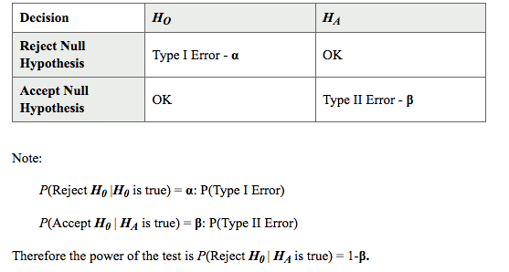
Determining Power

Slide 15
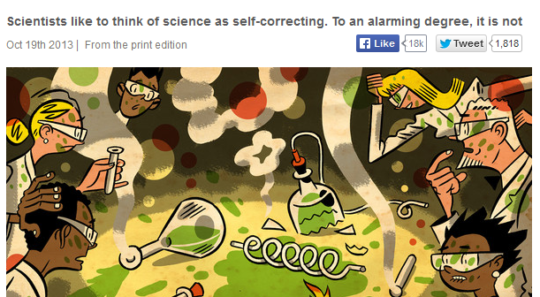
Reproducible Research?
The Economist
Notes:
Recent controversy about too many reports of research not reliable.

Slide 16
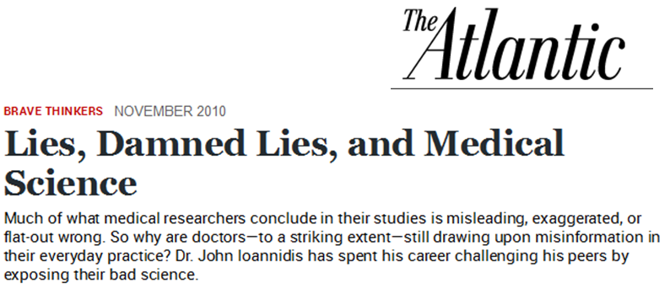
Can we count on science to produce reliable results?

Slide 17

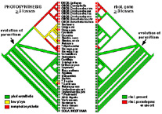
Two aspects of reproducibility
Reproducibility in the lab
data measurements
Reproducibility of the bioinformatics analysis
Paulson lab
From dePamphilis lab
Altman, 11/15

Slide 18

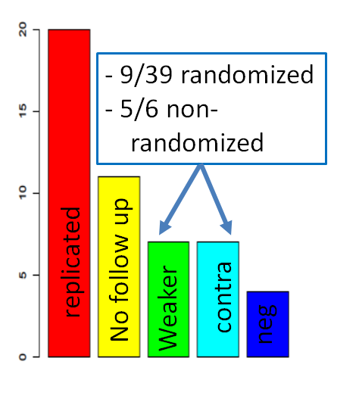
Reproducibility in the Lab
Ioannidis 2005 JAMA: “Contradicted and initially stronger effects in highly cited clinical research.”
Ioannidis 2005 PLoS Medicine “Why Most Published Research Findings are False”
Altman, 11/15
Notes:
Maybe skip this slide unless more background is obtained to document these numbers.

Slide 19
Reproducibility in the Lab
Ioannidis’ arguments:
Focusing on rare events – most discoveries are false
Publication bias: Only “interesting” events are published.
Detection bias: Selective or distorted reporting, conflicts of interest, deliberate manipulation
Lack of independent replication
Selection of most significant events instead of proper meta-analysis when there is replication
Altman, 11/15
Notes:
Why have we found ourselves with so much irreproducible research?

Slide 20
Reproducibility in the Lab
High false positive rates should be expected when:
Low power
Small studies: if the false positive rate is controlled, the false negative rate is high
Small effect sizes:
Large number of relationships tested without preliminary findings: lower prior probability of effect
High flexibility in designs, definitions, outcomes and analyzes: the search for significance
Rewards of research: winner takes all, so it pays to be first and to find something
Hot areas of research: research is rushed, lots of studies with low prior probability of effect
Altman, 11/15

Slide 21
Reproducibility in the Lab
Good experimental designs for obtaining reliable data:
Determine the population to which results are to be applied.
Be sure the experimental units are a random sample from this population.
Design measurements to avoid biases.
Altman, 11/15
Notes:
Preliminary steps to

Slide 22
Reproducibility in the Lab
Good habits for obtaining reliable data :
Follow lab procedures and protocols.
Document everything including failures and irregularities.
Keep a good lab book.
Every number should be auditable.
Notes:
Preliminary steps to

Slide 23
Reproducibility in the Lab
Reproducible ≠ Correct
We can ALWAYS get reproducible results if we:
Do biased experiments
Always accept (reject) our hypothesis
Correct is more important!!
Altman, 11/15

Slide 24
Reproducibility in the Lab
Statistical testing:
We do a test (e.g. t-test) and reject if P<α
(Reject means that we declare a “discovery”)
Usually we pick α=0.05 or 0.01
What is the probability that we have actually discovered something if we reject?
Altman, 11/15

Slide 25
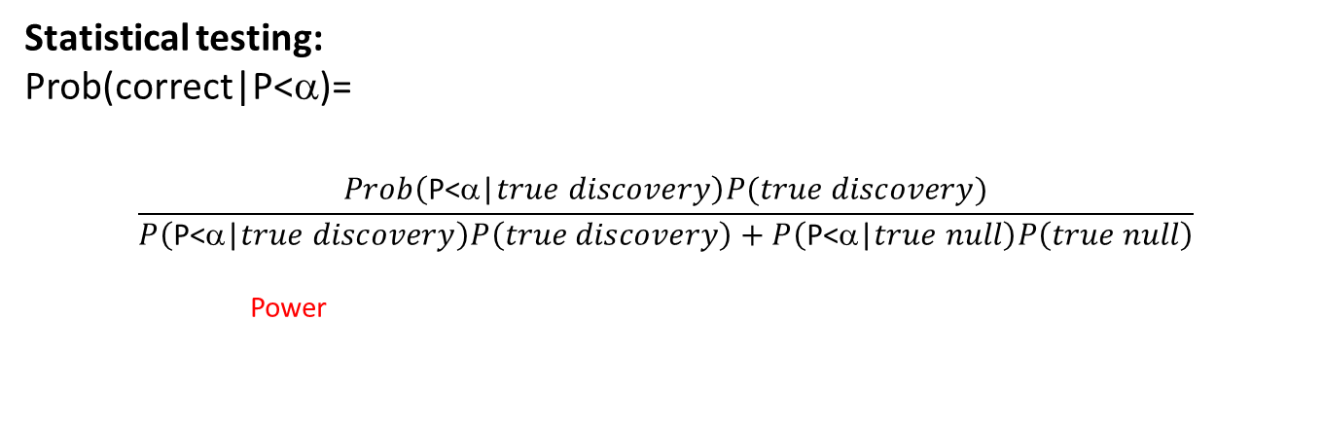
Reproducibility in the Lab
Statistical testing:
Prob(correct|P<α)=
Power
Prob Null is true | α | Power | Prob(correct|P<α) | Prob(correct|P>α) | Prob(reproducible |Correct reject)
95% | 0.05 | 0.80 | 46% | 99% | 64%
95% | 0.01 | 0.47 | 71% | 97% | 22%
50% | 0.05 | 0.80 | 94% | 83% | 64%
50% | 0.01 | 0.47 | 98% | 68% | 22%
Altman, 11/15

Slide 27
A Story
A court case challenged the accuracy of routine clinical lab measurements of BAC
Claimed that although measurements were correlated, they were not accurate
Indeed correlated measurements does not establish equivalence between two methods
Analysis of an inter-laboratory study showed that the WB method routinely used, was accurate compared to the GC method, considered the gold standard

Slide 28
Com v Daughenbaugh et al
Brief describing the proceedings…

Slide 29
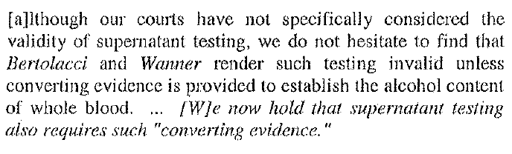
Example of establishing accuracy
This was the challenge to the accuracy of the local
laboratory testing procedure.
The defendant dredged up an old ruling that suggested
that the laboratory procedure was flawed and required
a conversion factor.

Slide 30
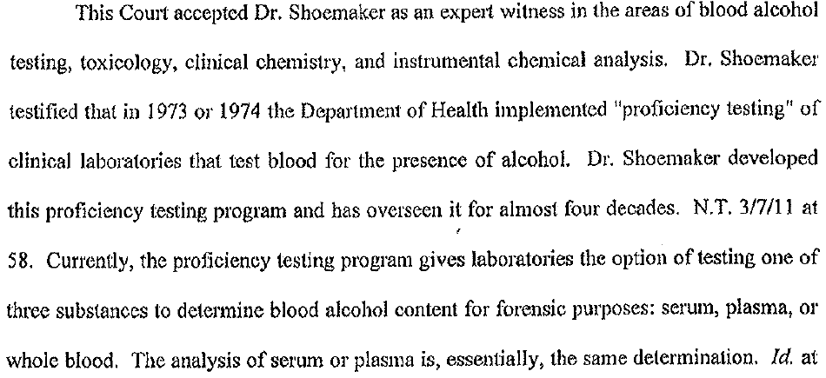
Testing of Clinical Laboratories

Slide 31
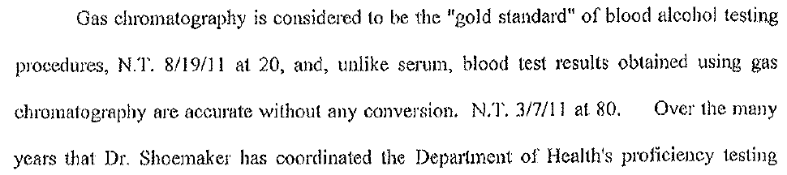
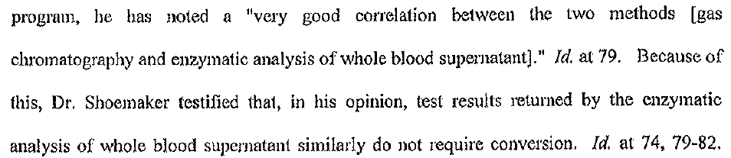
Gold Standard

Slide 32
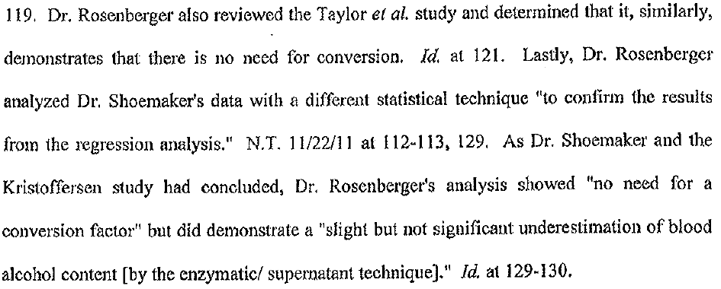
Conclusion: No need for a conversion factor to use plasma methods

Slide 33
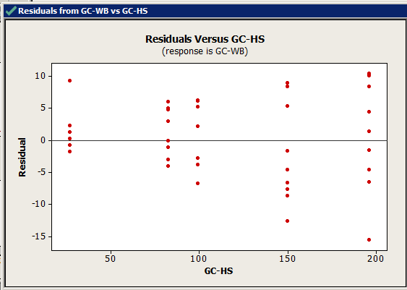
Results from Bland and Altman

Slide 34
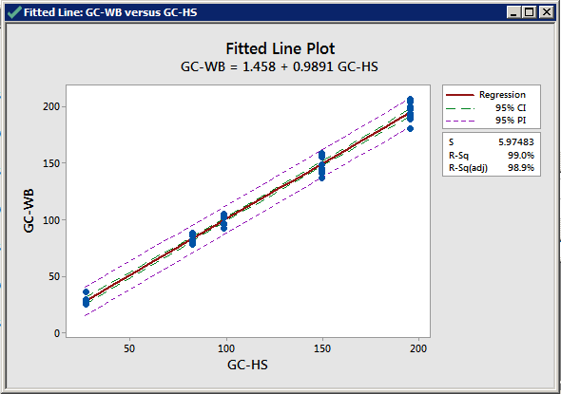
Regression of Y on X

Slide 35
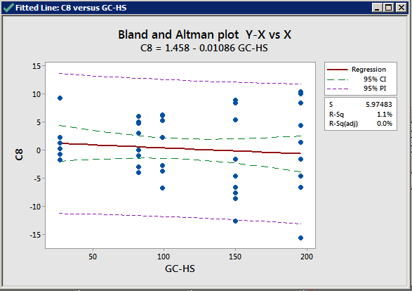
Expanded view of regression result

